Slide 1
Statistics 367-1-4361 Hierarchical Models
Opher Donchin

Slide 2
8A Review

Slide 3
8B Overfitting and underfitting

Slide 4
Occam’s razor
Given two explanations that both explain the phenomena
Prefer the simpler
William of Ockham 1287-1347
English Friar and Theologian
Used the principle effectively
Attributed to him by philosophers in 1600s
Chatton’s anti-razor
Contemporary disputant of William of Ockham
If three assumptions are not enough to explain the phenomena
A fourth will be necessary

Slide 5
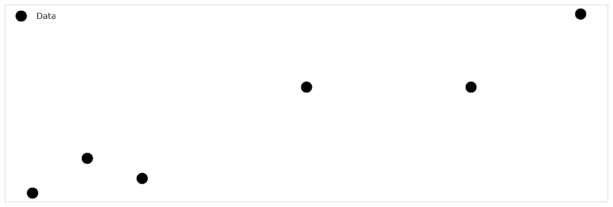
Some data

Slide 6
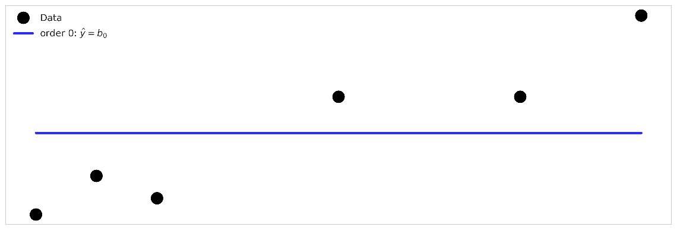
A model that underfits

Slide 7
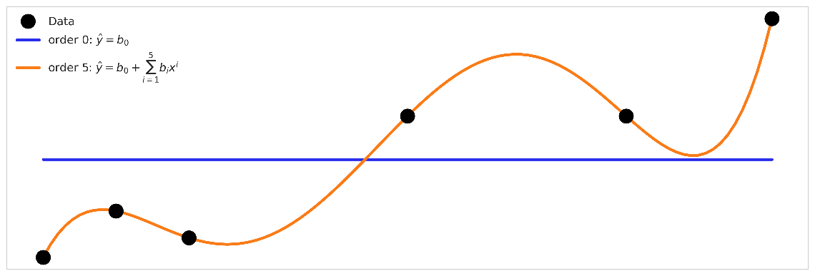
A model that overfits

Slide 8
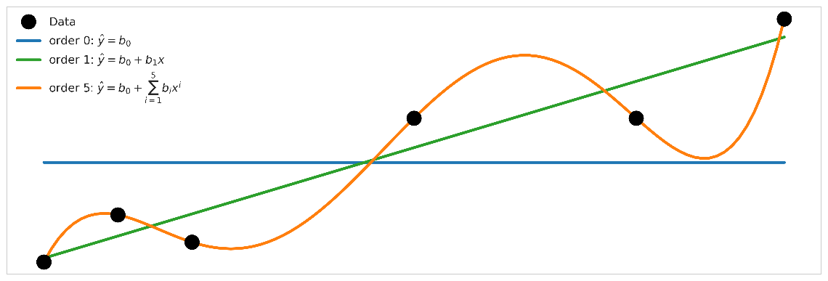
A model that balances overfitting and underfitting?

Slide 9
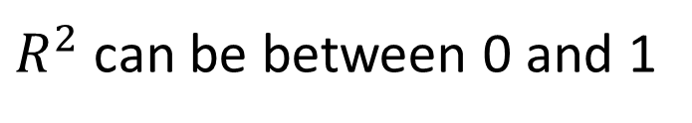
Coefficient of determination
How much the model explains
Out of how much could be explained
$R^{2}$ can be between 0 and 1

Slide 10
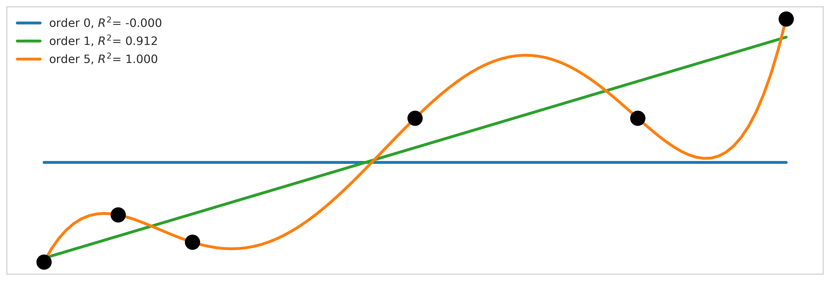
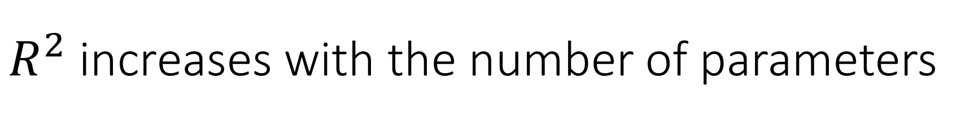
$R^{2}$ increases with the number of parameters

Slide 11
How well should a model fit?
A model that is too simple
Like a prior that is too strong
Choice of model determines results
The data doesn’t speak
A model that is too complex
Like a prior that is too weak
Results become noisy

Slide 12
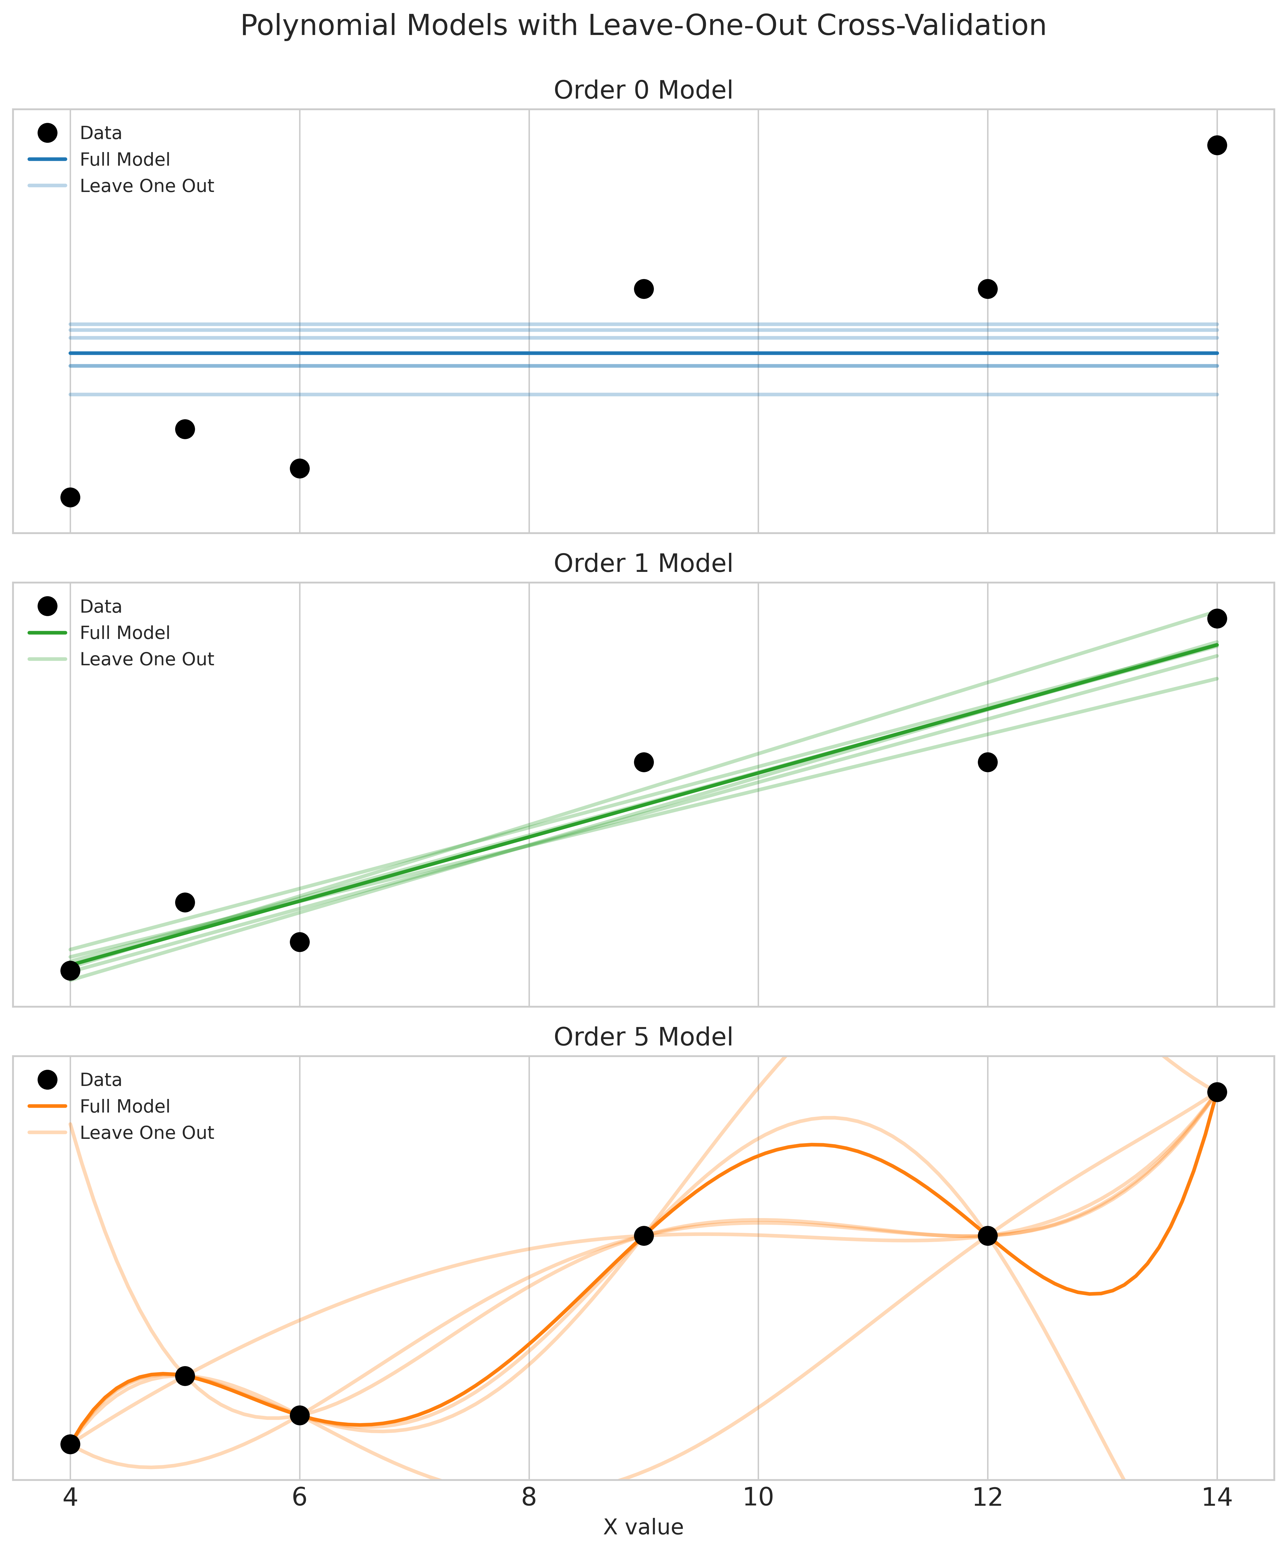
Leaving out one data point
Overfit model
Overly sensitive to data details
Underfit model
Ignores important details

Slide 13
8B What makes a good model?

Slide 14

All models are wrong
Indeed. We would not want them to be perfect!
We need them to be wrong in the right way?
On Exactitude in Science Jorge Luis Borges, Collected Fictions, translated by Andrew Hurley.
…In that Empire, the Art of Cartography attained such Perfection that the map of a single Province occupied the entirety of a City, and the map of the Empire, the entirety of a Province. In time, those Unconscionable Maps no longer satisfied, and the Cartographers Guilds struck a Map of the Empire whose size was that of the Empire, and which coincided point for point with it. The following Generations, who were not so fond of the Study of Cartography as their Forebears had been, saw that that vast Map was Useless, and not without some Pitilessness was it, that they delivered it up to the Inclemencies of Sun and Winters. In the Deserts of the West, still today, there are Tattered Ruins of that Map, inhabited by Animals and Beggars; in all the Land there is no other Relic of the Disciplines of Geography. —Suarez Miranda,Viajes de varones prudentes, Libro IV,Cap. XLV, Lerida, 1658

Slide 15
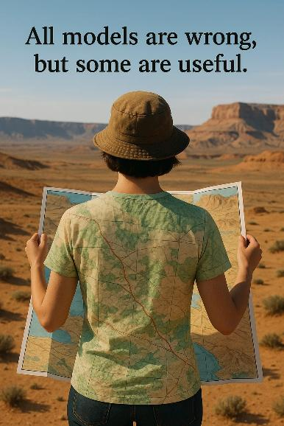
Some models are useful
So what can they be useful for?
Hypothesis testing
Prediction
Interpretation
Different uses, different goals

Slide 16
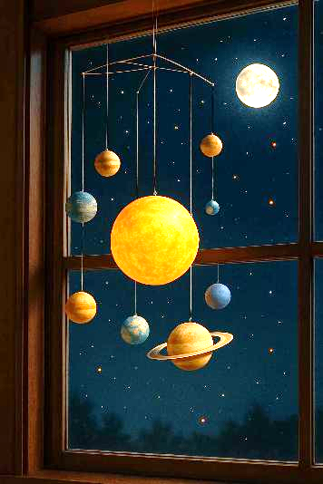
Theory building
Models underlie our understanding
Especially scientific understanding
Reflect important truths about reality
Better models reflect important parts
More faithfully
A good model must be:
Interpretable
Meaningful
Generalizable
Science is: accepting good enough models

Slide 17
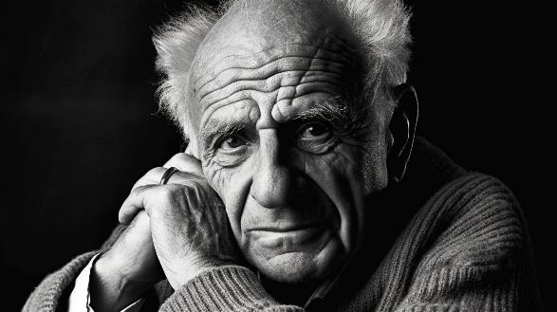
Hypothesis testing
Karl Popper The Logic of Scientific Discovery 1934
Scientific theories can’t be proven, but only falsified
Practically this lead to:
Progress through falsifying simplistic theories
Statistical tests to reject simple theories
No different / no effect / no influence
Science is: rejecting bad models

Slide 18
Prediction
Up until the 1970s
Focus on finding ‘true’ parameter values
Focus on hypothesis testing
1970s: The link through information theory
Find the model ‘closest’ to the true model
Notice connection to predictive accuracy
1980s: The prediction revolution
Mervyn Stone 1983
A.P. Dawid 1984
Under the best model, future data is likely
Science is: comparing candidate models

Slide 19
What makes a good model?
Theory building
Science is accepting good enough models
Good models explain the phenomenon
Hypothesis testing
Science is rejecting bad models
Good models are what remains after the bad ones are rejected
Predictive power
Science is comparing candidate models
Good models have better predictive power

Slide 20
8C ROPE and HDI

Slide 21
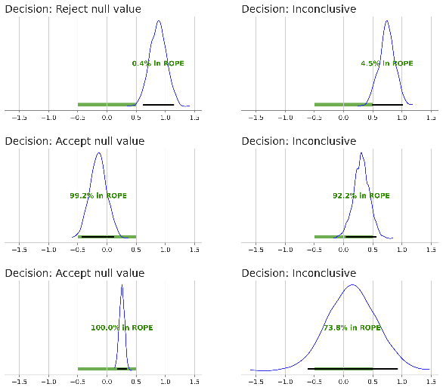
Reminder: Using the HDI and the ROPE
HDI doesn’t overlap ROPE
Reject null model
Falsified!!
Popperian hypothesis testing
HDI within ROPE
Accept null model?
Falsify vague alternative possibilities
Otherwise
Inconclusive
Get more data or rethink experiment

Slide 22
HDI and ROPE as model comparison
Compare
A model centered near the null value
All other models
If one is falsified
The other model is better
Weaknesses
Arbitrary ROPE
Arbitrary HDI width
Poorly specified alternatives
Strengths
Simple to apply
Simple to understand
Clear parallels in frequentist methods

Slide 23
What makes a good model?
Theory building
Science is accepting good enough models
Good models explain the phenomenon
Hypothesis testing
Science is rejecting bad models
Good models are what remains after the bad ones are rejected
Predictive power
Science is comparing candidate models
Good models have better predictive power
Rope and HDI

